Slide 1





Next Gen Employability Program
NEXT GEN EMPLOYABILITY PROGRAM
Creating a future-ready workforce
Team Members
College Name
IMAYABHARATHI M
Student Name :
Student ID :
6235-AVS COLLEGE OF TECHNOLOGY
623521104022
Notes:
1

Slide 2

Next Gen Employability Program
CAPSTONE PROJECT SHOWCASE
TOM bus system
Building Bus Reservation System using Python and Django
Abstract | Problem Statement | Project Overview | Proposed Solution | Technology Used | Modelling & Results | Conclusion

Slide 3
Next Gen Employability Program
Abstract
>A Python and Django-based bus reservation system facilitating online booking and man
>Streamlined platform for users to reserve bus tickets efficiently using Python and Django.
>Simplified bus ticket booking system developed for seamless user experience
>Python and Django-powered bus reservation system offering convenient booking
and administration capabilities.
>Efficient bus reservation platform created with Python and Django,
ensuring smooth ticket booking and management.
Source :
Python,html, django

Slide 4
Next Gen Employability Program
Problem Statement
Develop a web-based bus reservation system using Python and Django framework.
Allow users to search for bus routes, view available seats, and make reservations online.
Implement secure user authentication and payment integration for booking confirmation.
Provide administrators with a dashboard to manage buses, routes, and reservations.
Ensure scalability and efficiency through optimized database design and responsive UI.
Source :

Slide 5
Next Gen Employability Program
Project Overview
Overview: The bus reservation system project aims to provide a user-friendly platform for passengers to book bus tickets online. It simplifies the process of ticket booking, seat selection, and payment, making it convenient for both passengers and bus operators.
Source :

Slide 6
Next Gen Employability Program
Proposed Solution
.
Used for for bus searching and booking
Seat selection
Booking conformation
Cancellation
Source :

Slide 7


Next Gen Employability Program
Technology Used
Front-end
Back-end
Source :

Slide 8
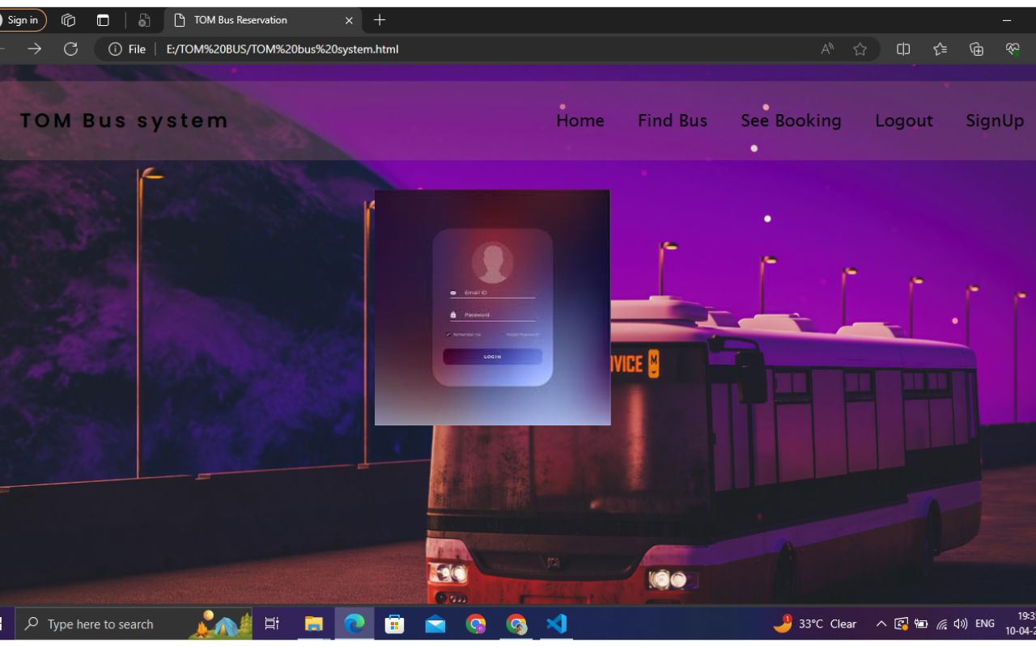
Next Gen Employability Program
LOGIN-Page

Slide 9
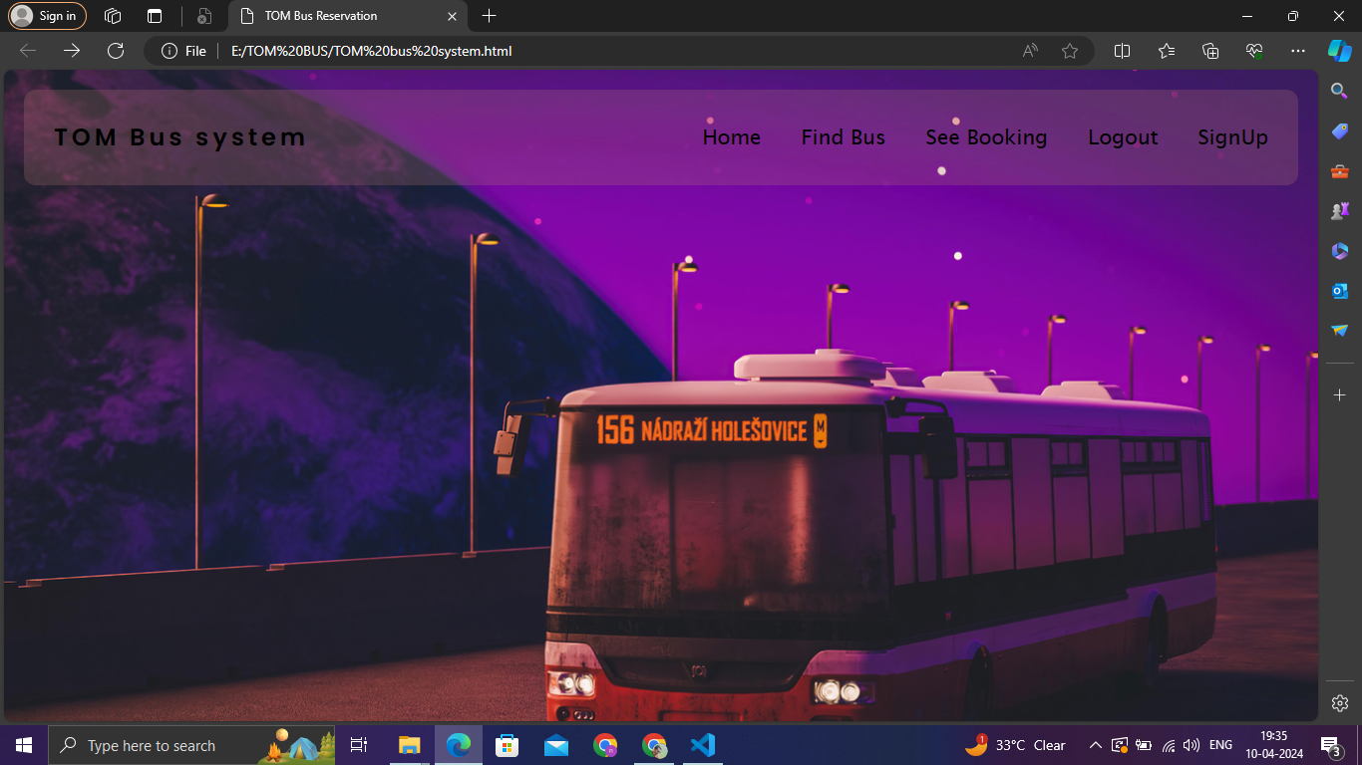
Next Gen Employability Program
Homepage

Slide 10
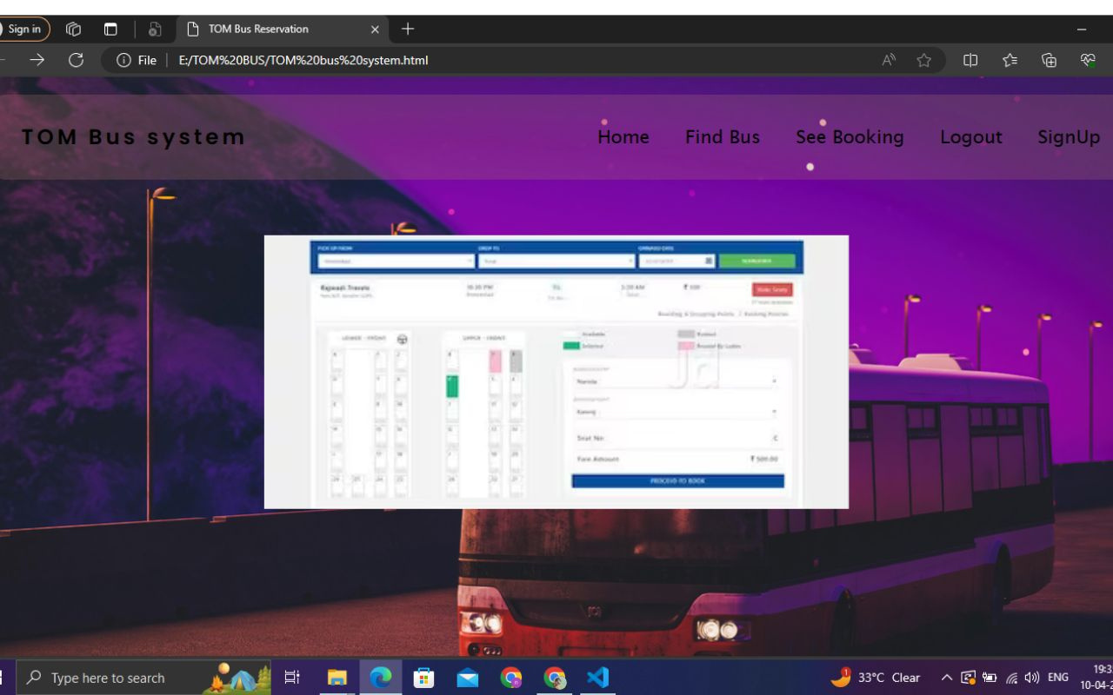
Next Gen Employability Program
search bus
Source :

Slide 11
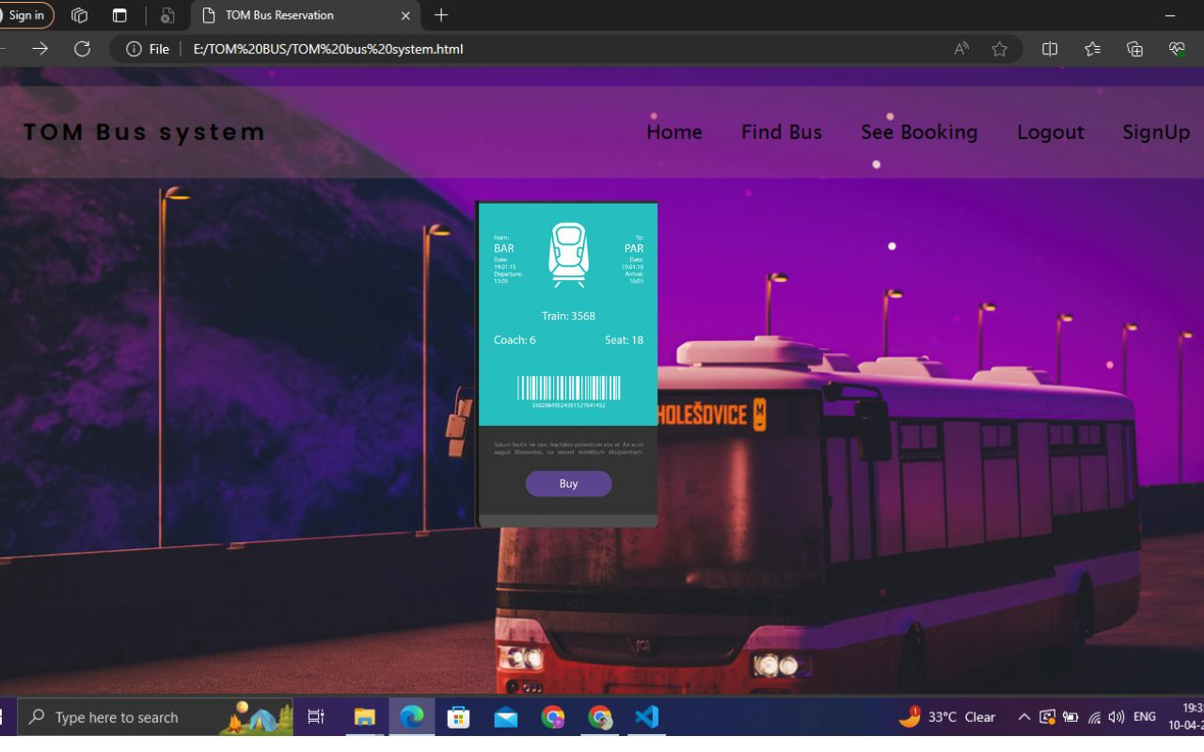
Next Gen Employability Program
ticket booking&cancel

Slide 12
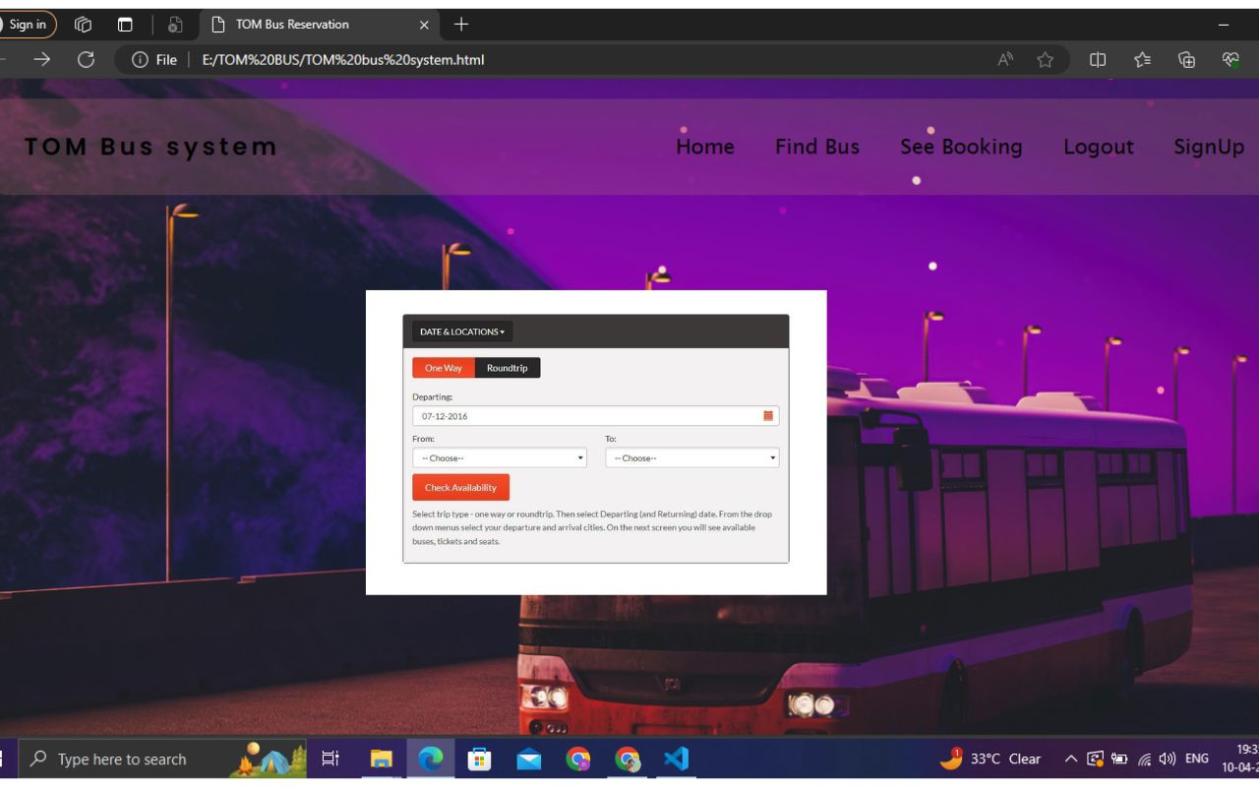
Next Gen Employability Program
Service-Page

Slide 13
Next Gen Employability Program
Future Enhancements:
Administrative tools
Smart ticket verfication
Secure payment process

Slide 14
Next Gen Employability Program
Conclusion
Our bus resrevation system can be use to very easy to understand to make book atickets to use secure pament enjoy the joureny.
Source :

Slide 15
Next Gen Employability Program
Thank You!
Notes:
Thank You !!

